Slide 1

President’s Retreat 2020:
“Getting Better by Deeply Understanding the Current State”
Provost Beth Boehm

Slide 2
Definitions

Slide 3
Retention and Persistence
First year retention rates are calculated using the Graduation Rate Survey (GRS) cohort (first-time, full-time, baccalaureate degree seeking students). Part-time and transfer students are excluded from the cohort.
Retention rates are calculated from fall semester to fall semester; enrollments in spring and summer semesters are not considered.
Data displayed by unit represent the student’s unit of initial enrollment.
Persistence is defined as continued enrollment (year to year retention) and includes degree completion.

Slide 4
Graduation
6-year graduation rates are calculated using the Graduation Rate Survey (GRS) cohort (first-time, full-time, baccalaureate degree-seeking students).
  Part-time students and transfer students are excluded from the cohort.
  Valid exclusions defined by the US Department of Education (military service, missionary service, death) are reflected in the 6-year graduation rate only.
6-year graduation rates are calculated once a year and include the trailing summer.

Slide 5
Progression
Progression definitions are based on the CPE Performance Metrics as follows:
Student Progression (30 Hours): The number of full- and part-time undergraduate students reaching or surpassing 30 cumulative earned credit hours in a given academic year as defined by student classification.
Student Progression (60 Hours): The number of full- and part-time undergraduate students reaching or surpassing 60 cumulative earned credit hours in a given academic year as defined by student classification.
Student Progression (90 Hours): The number of full- and part-time undergraduate students reaching or surpassing 90 cumulative earned credit hours in a given academic year as defined by student classification.

Slide 6
How are we performing overall?

Slide 7
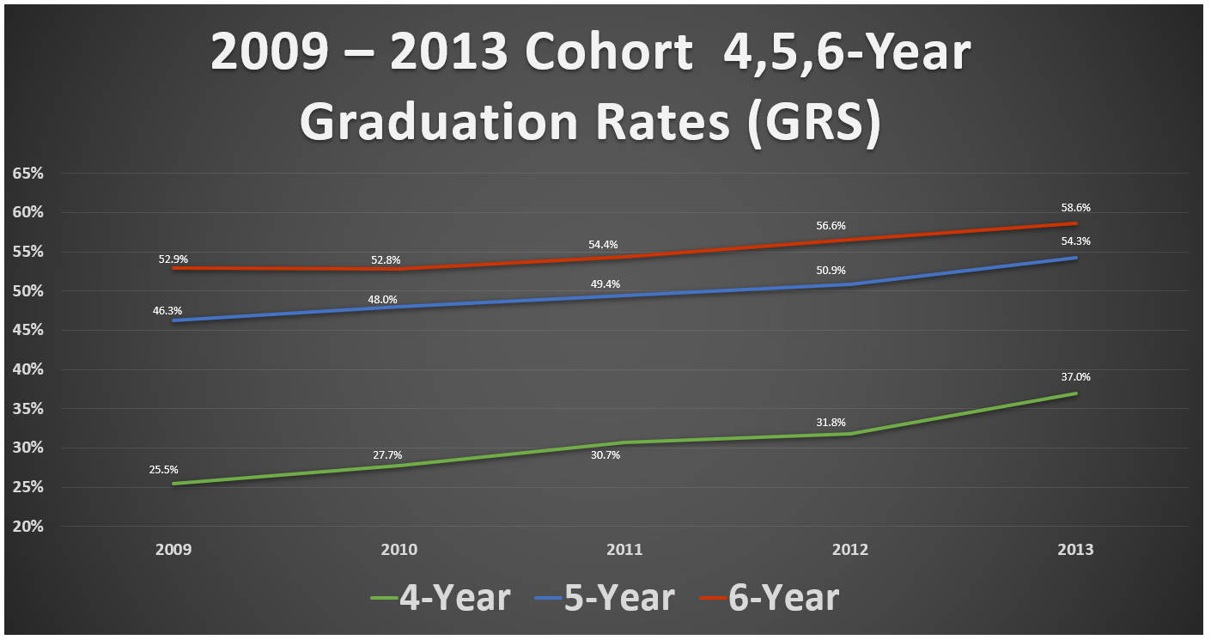

Slide 8
How are we performing by strategic priority populations?
Office of Institutional Research and Planning: Goldstein, Fry, Horn, Ruffin, Young, January 2020

Slide 9
Strategic Priority Populations
Priority populations are defined by the Kentucky Council on Postsecondary Education (CPE) as follows:
Underfunded: Pell grant recipient during year of entry.
Underrepresented Minority: Students who self-identify as Black, American Indian or Alaskan Native, Hispanic or Latino, Native Hawaiian or Other Pacific Islander, and two or more races.
Underprepared: Students who are not college-ready in one or more of the following subjects: writing, reading, and mathematics.
These priority populations are not mutually exclusive (see Venn diagram later in presentation).

Slide 10
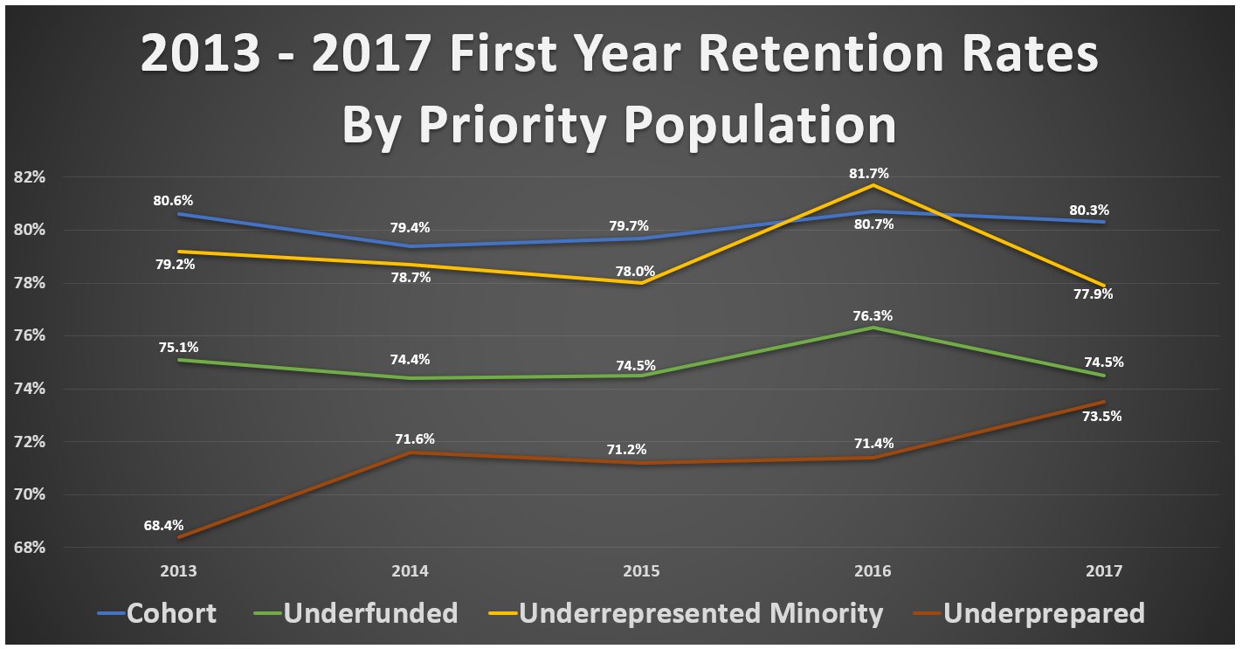

Slide 11
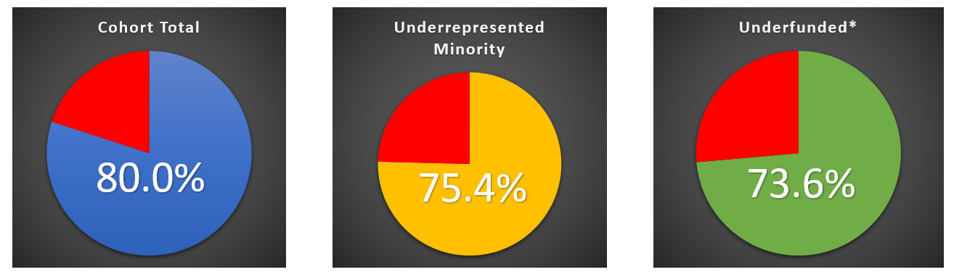
2018 First Year Retention Rates
By Priority Population*
*Note: Data for Underprepared population are under reconciliation with CPE and are not available.
Data for Underfunded population are preliminary pending reconciliation with CPE.

Slide 12
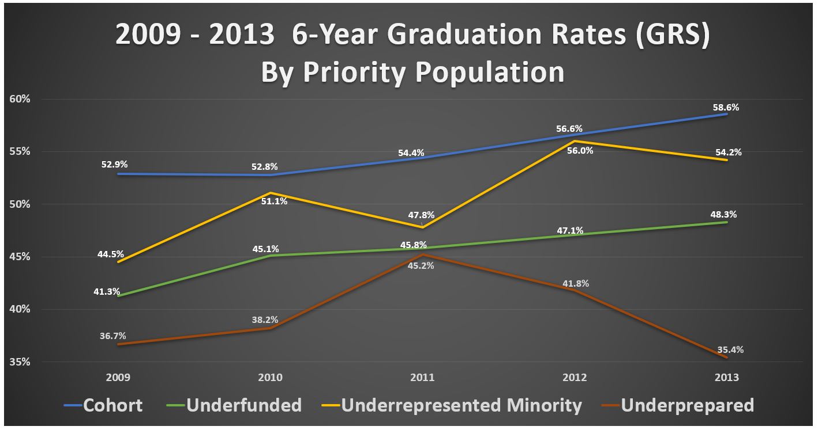

Slide 13
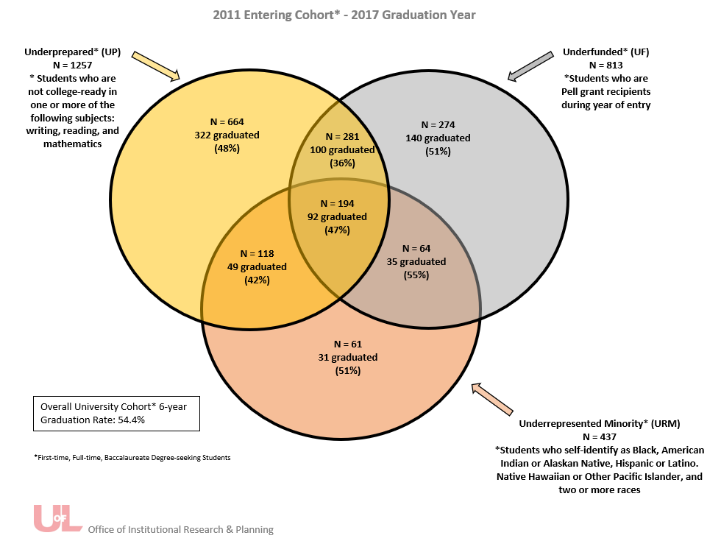
Fall 2011 Cohort 6-Year Graduation Rate
By Priority Population

Slide 14
How are we performing by Unit?

Slide 15
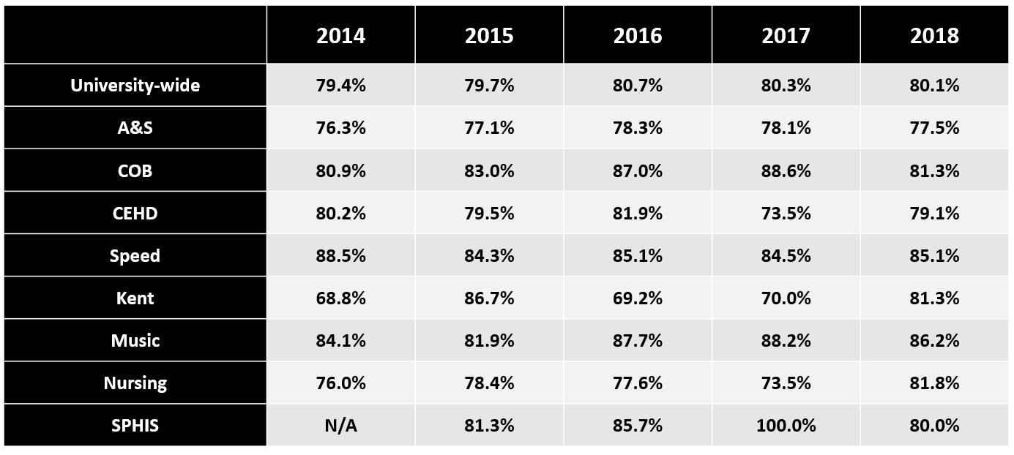
2014 – 2017 First Year Retention Rates By Unit

Slide 16
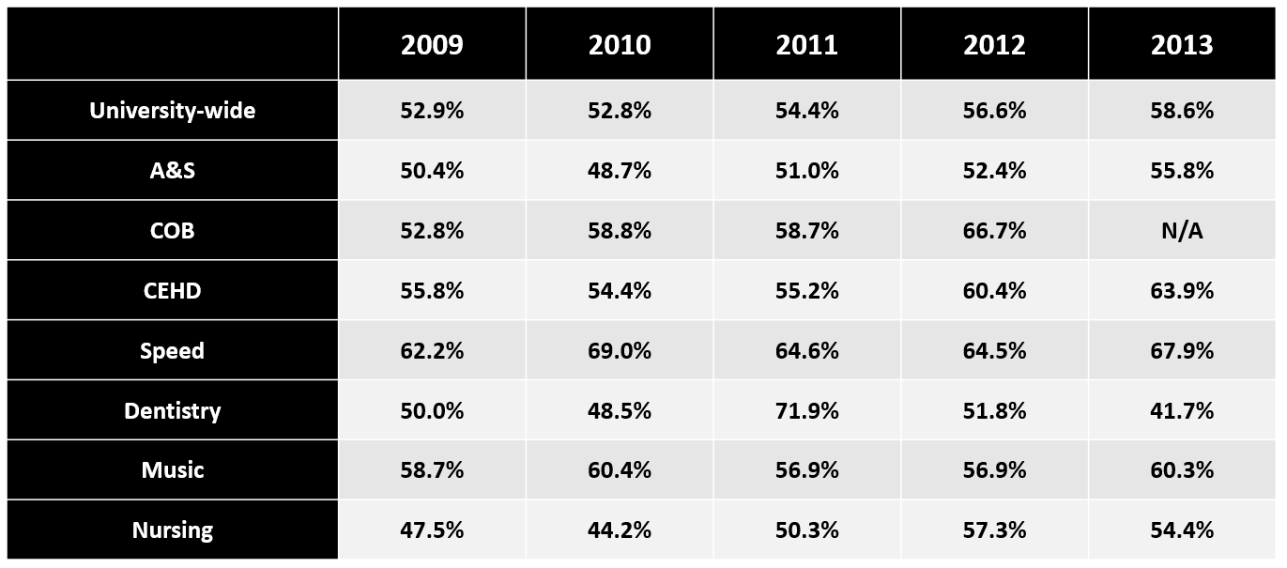
2009 – 2013 6-Year Graduation Rates (GRS) By Unit
*Note: College of Business, Kent, and SPHIS did not admit undergraduate cohorts during these years.

Slide 17
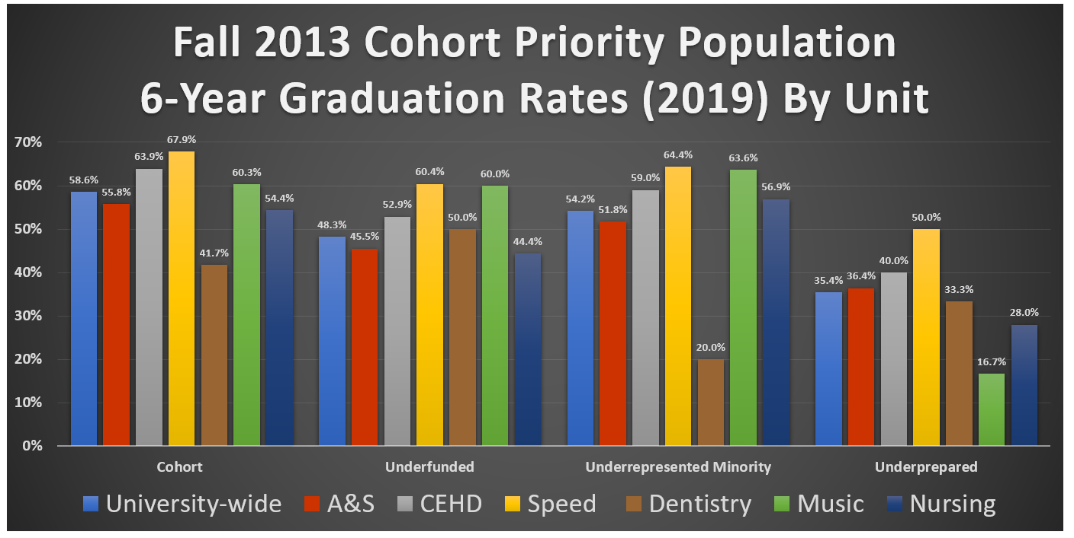
*Note: College of Business, Kent, and SPHIS did not admit an undergraduate cohort in Fall 2013.

Slide 18
What retention initiatives have worked?
Associate Provost Beth Willey

Slide 19
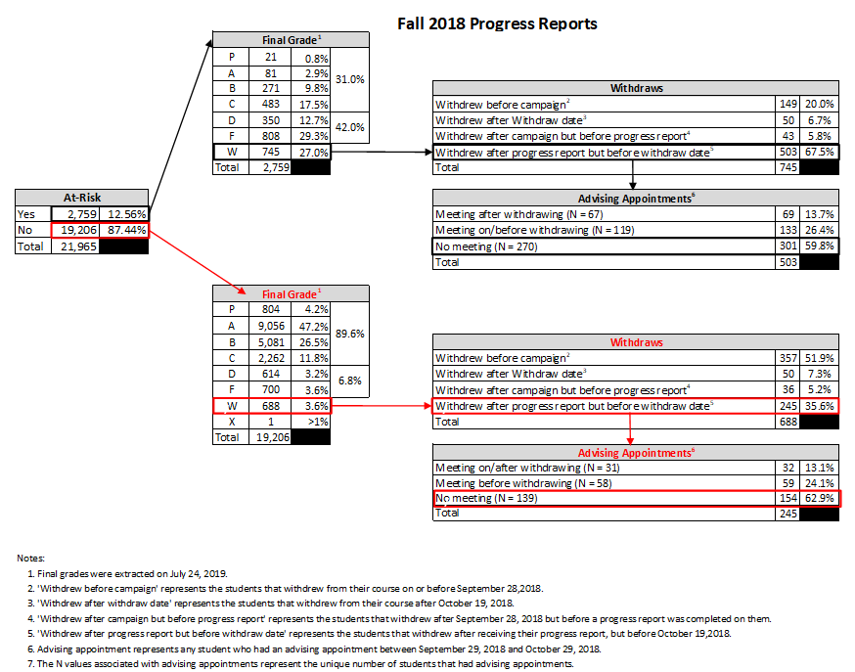
Undergraduate Progress Reports

Slide 20
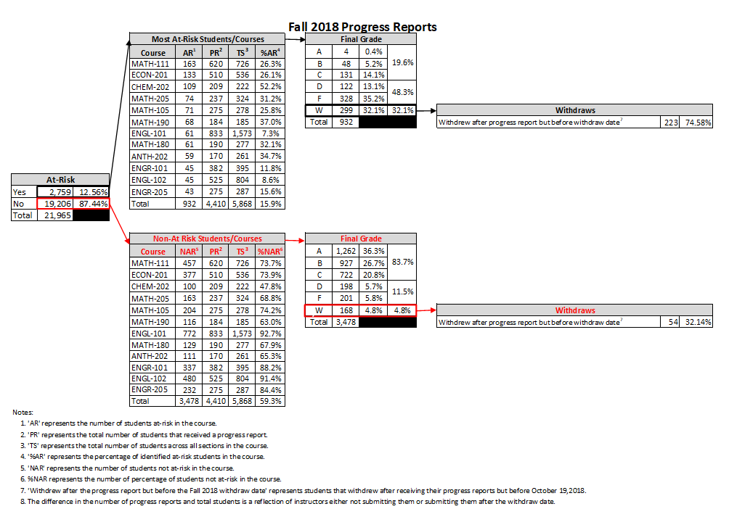

Slide 21
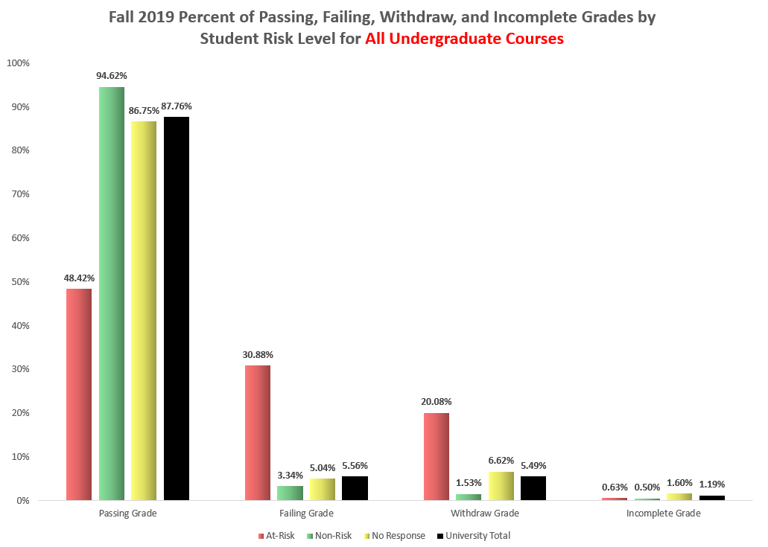

Slide 22
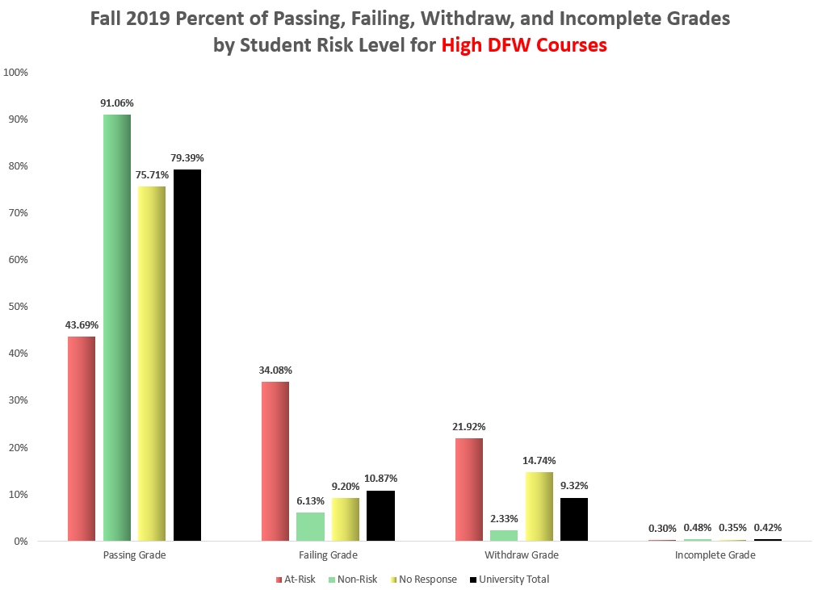

Slide 23
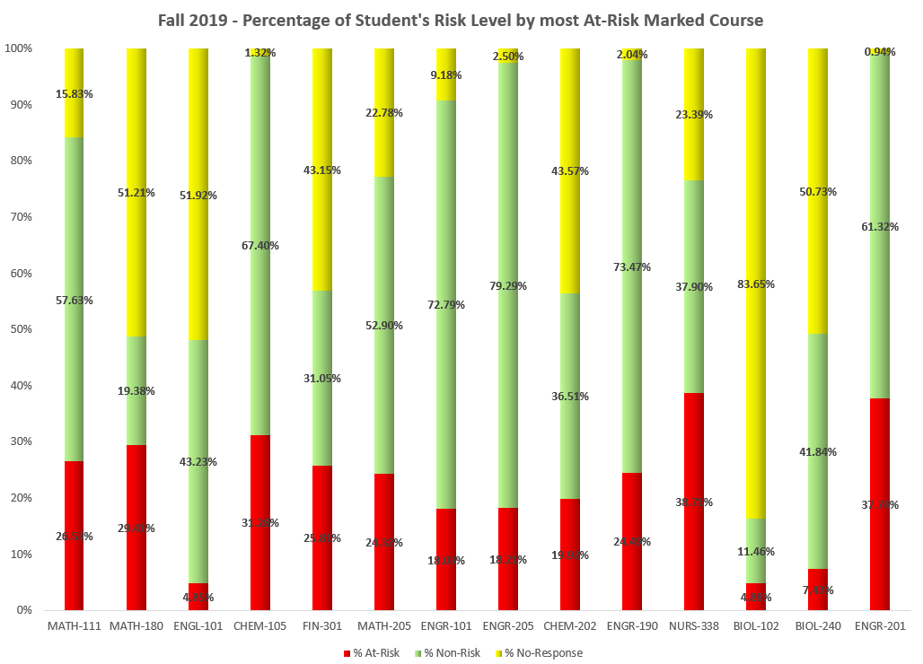

Slide 24
What retention initiatives have worked?
Reports from the Units

Slide 25
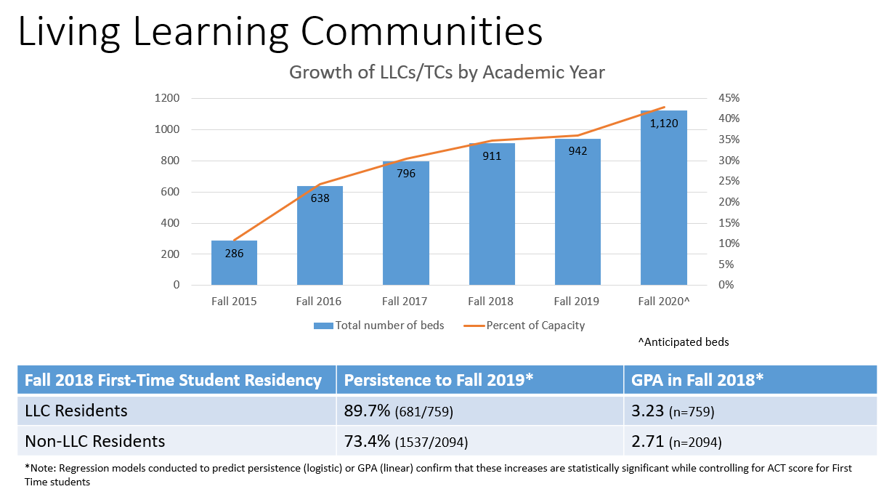
Office of Student Affairs

Slide 26
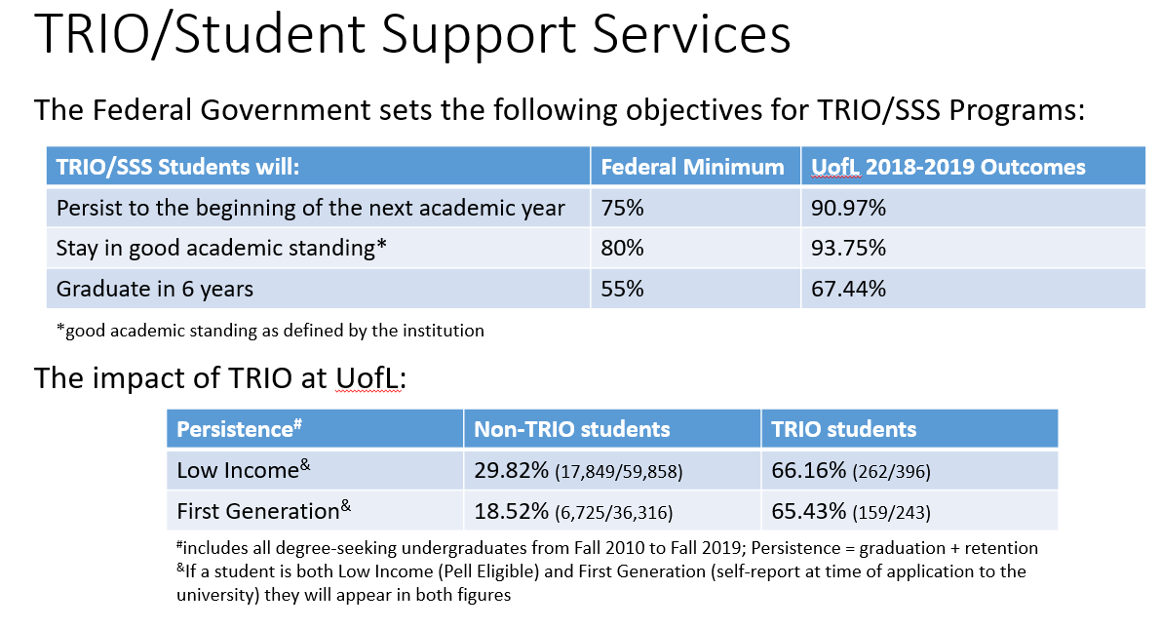

Slide 27
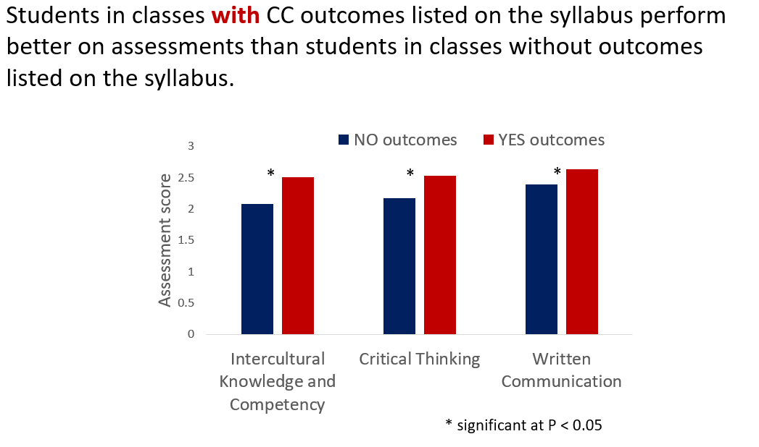

Slide 28
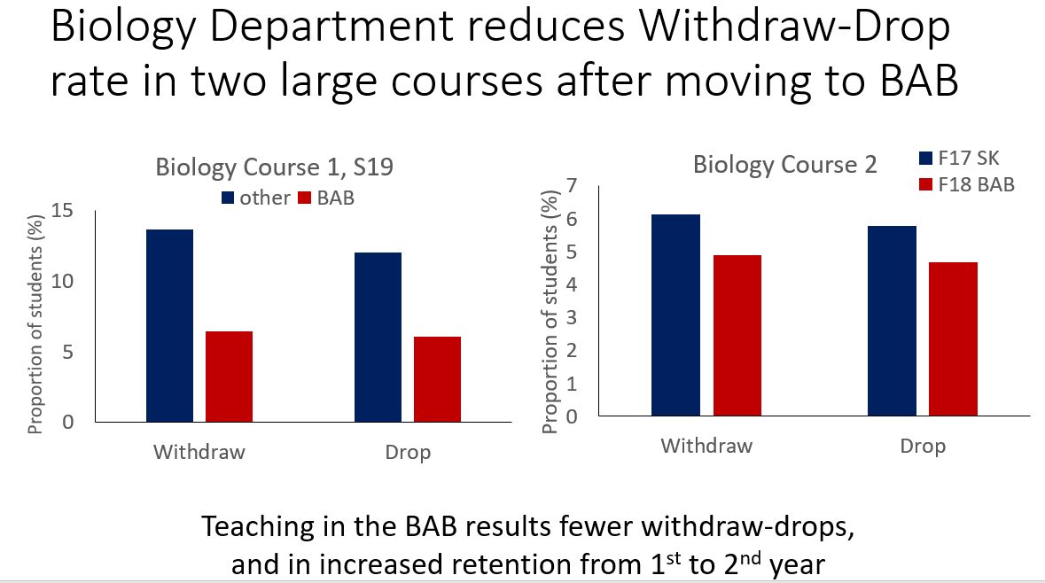

Slide 29
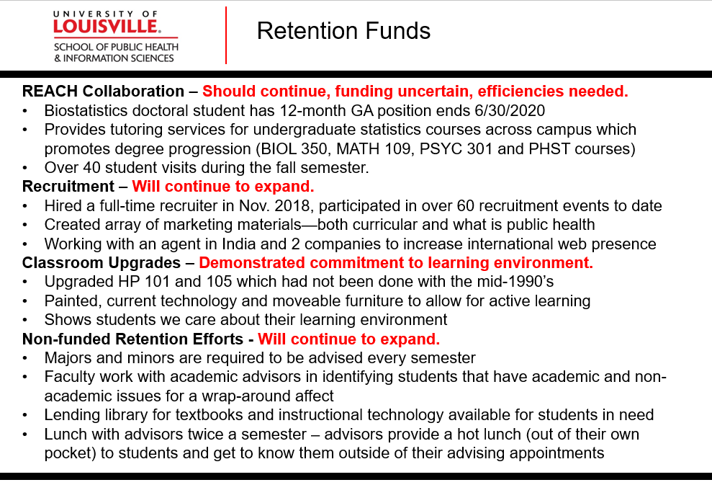

Slide 30
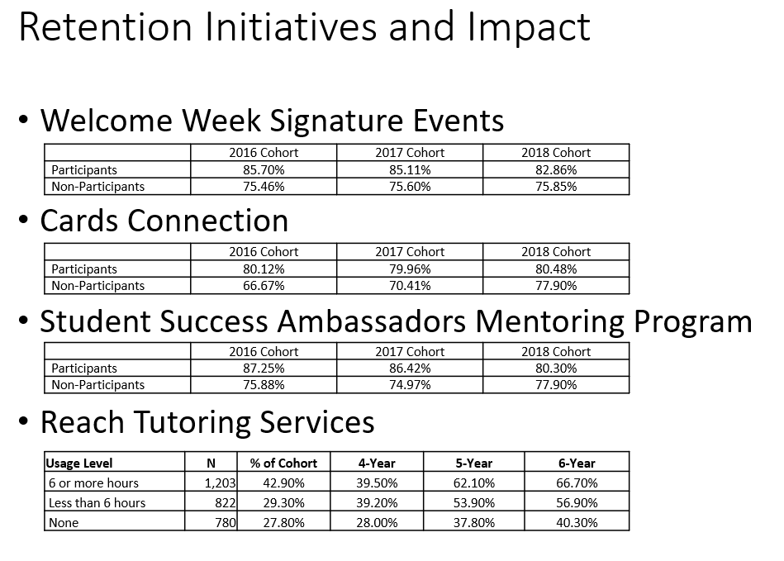

Slide 31
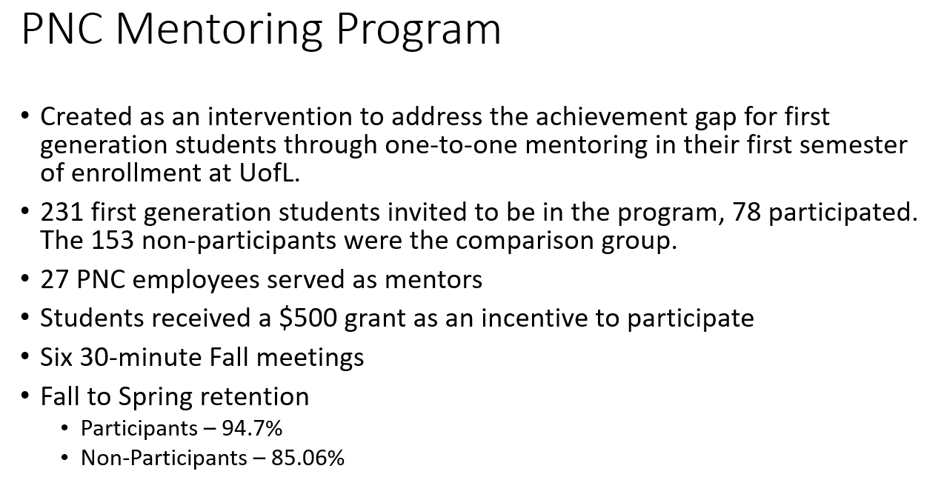

Slide 32
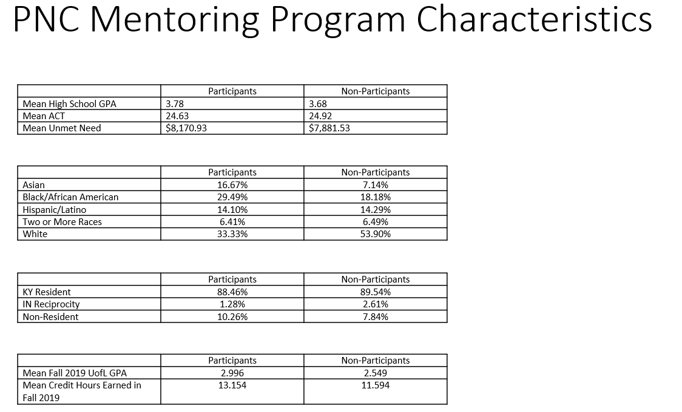

Slide 33
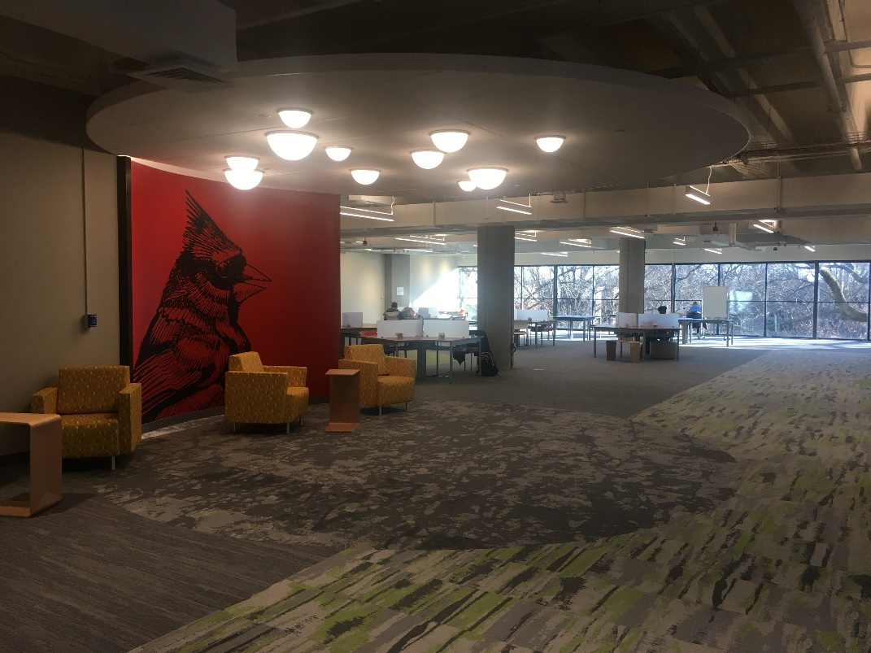
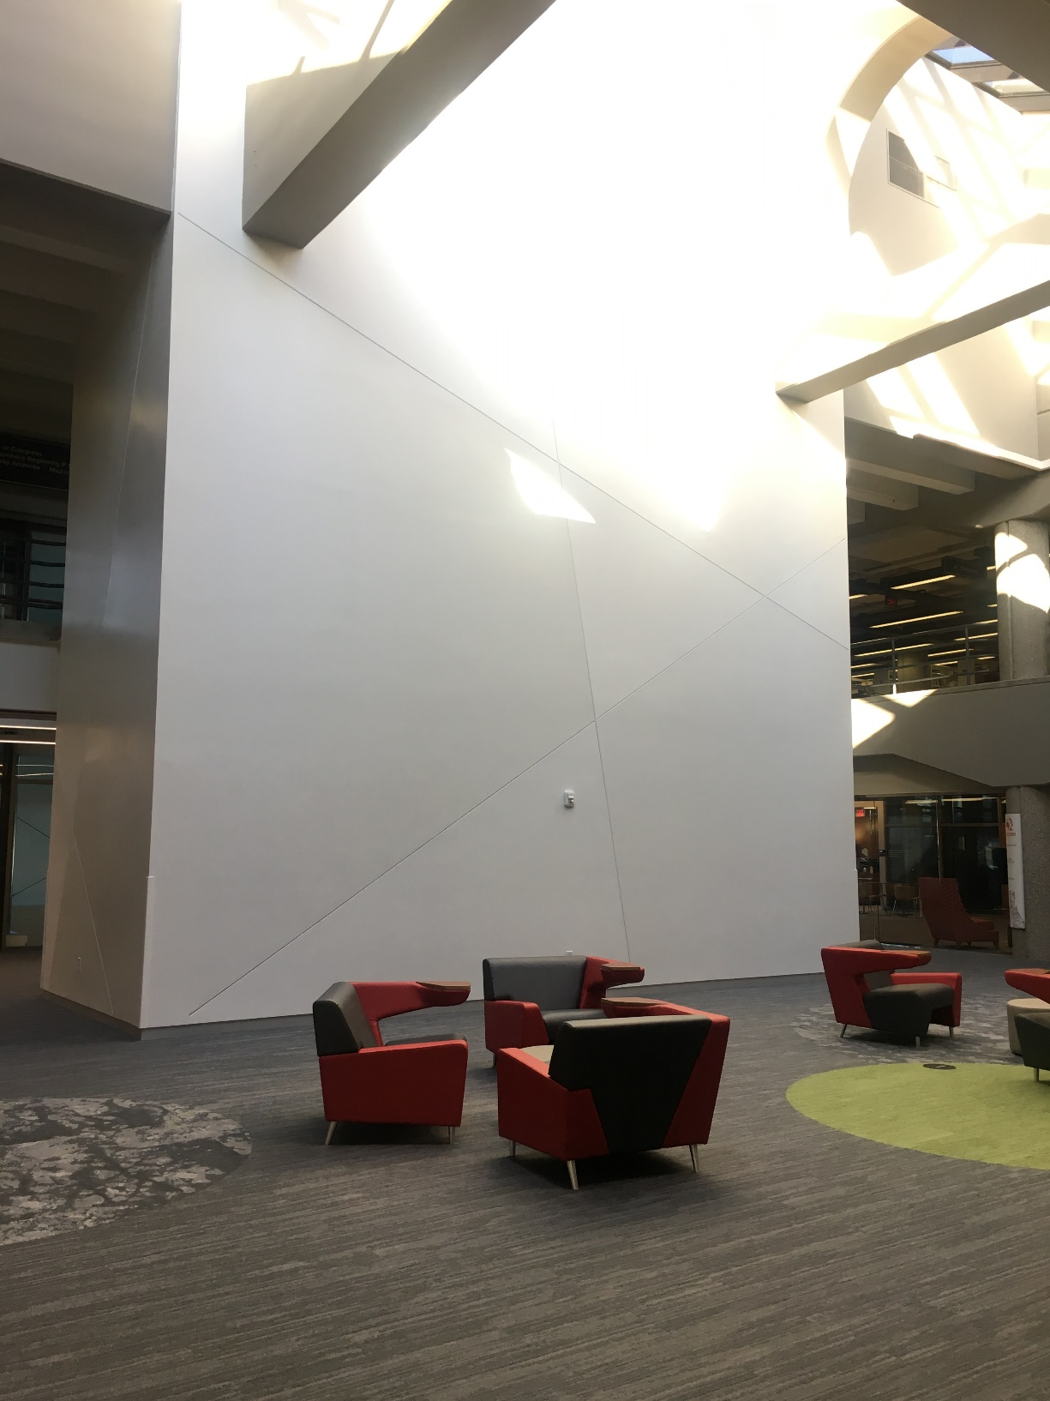
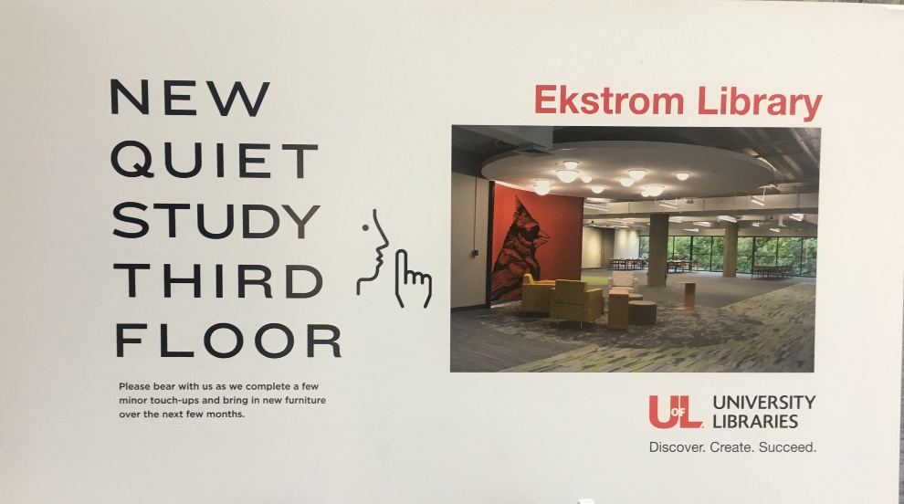
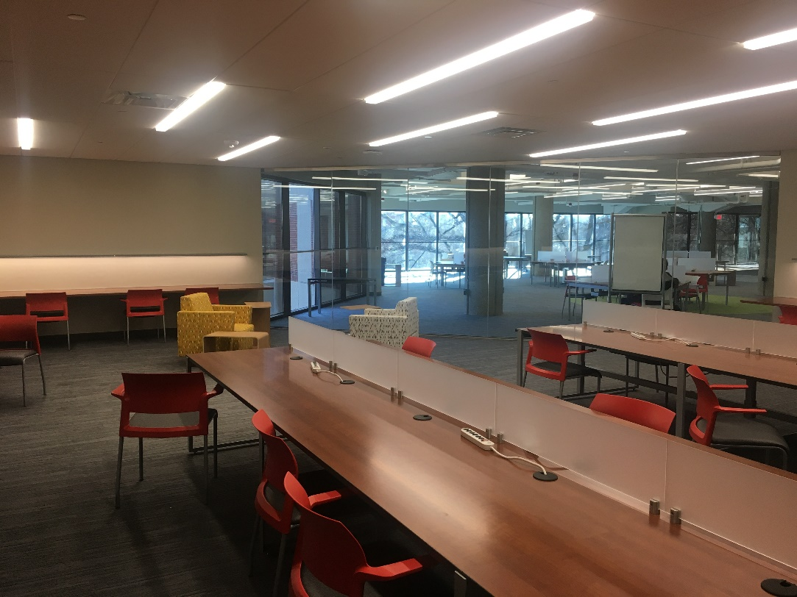

Slide 34
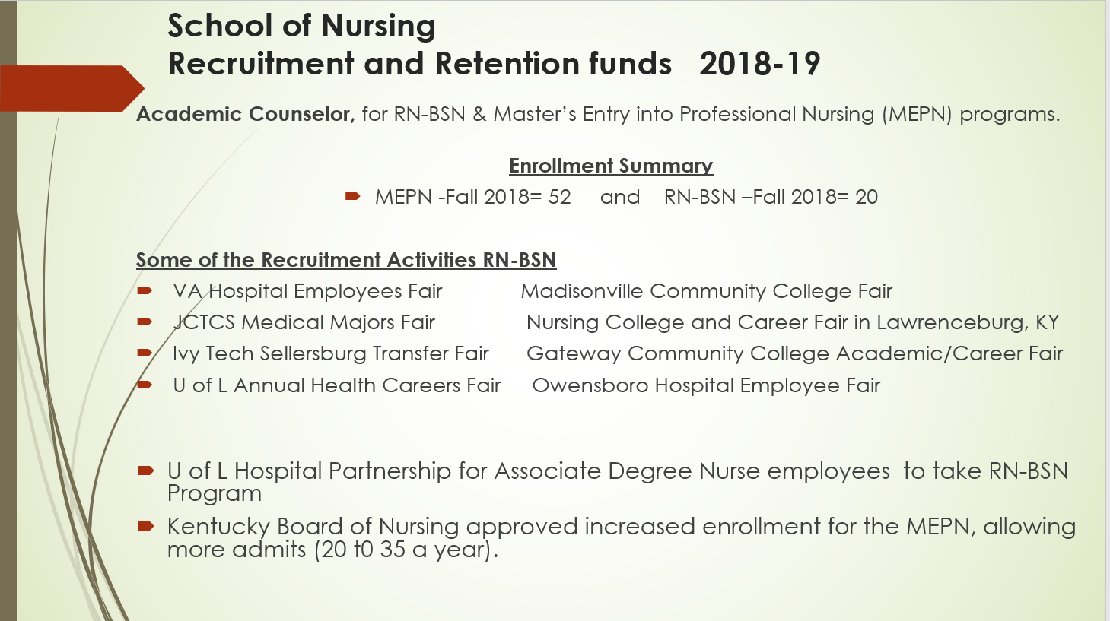

Slide 35
Closing the Opportunity Gap: URM, Underprepared, Underfunded
Cultural Center: Dedicated Site for URM students, RSOs, Diversity Programming
  Porter Scholars (1984): Largest scholarship for African-American students
    LLC
    Leadership training
    Dedicated Success Coaches
  Black Male Initiative (2011)
    LLC
    Brothers United RSO
    Service and leadership development opportunities
    Dedicated Mentoring Program
TRIO for Low Income and First Generation
  Dedicated Support Specialists
  Study skills development and academic success workshops
  Professional mentoring
  Financial assistance/Financial literacy program
Adaptive Learning Courseware for Underprepared Students
  Math: GEN 103/104 (APLU/Gates project)
  Spring 2019 success rate 73.4% for white students, 73.3% for URM (pending verification)
  Since 2016, 70% of students who completed GEN 103/104 passed their required math course

