Slide 1
Financial Aid & Money Management
For Entering Medical Students Class of 2028
University of Louisville – SOM Orientation
Angela Hall
Financial Aid Coordinator for SOM

Slide 2
Welcome
Class of 2028!

Slide 3

SOM Financial Aid Staff
Leslie R. Kaelin, M.Ed.
SOM Financial Aid Director
Angela Hall, MSM
SOM Financial Aid Coordinator
Located in:
SOM A Building
Suites 204 & 205 (across from Student Affairs)
502-852-5187

Slide 4
Functions of Different Offices:
SOM - Financial Aid:
Assist with account questions
Additional loan offers/loan reductions
Post internal awards
Billing for NHSC
Counseling
Financial Literacy Events
Bursar’s office:
Student Billing
Refunds (Student Choice - Nelnet)
Third Party Billing
  VA and Military HPSP
Takes payments
Main Campus Financial Aid:
Clear Conflicting info on FAFSA
Process Verification
Clears Citizenship
Posts outside scholarships
Packaging processing
Campus Health Services:
Waving Major Medical Insurance
Questions regarding medical coverage

Slide 5

Financial Literacy Provided by our Office:
We Make Financial Literacy Fun!
M1 - The Price is Right! - Topic: Goals and Budgeting (Fall)
M1 - Fashion $ense Show (Spring) College competition - “Doing More with Less”- Celebrity SOM Judges
M2 - So You Want To Be a Millionaire? - Credit Reports and Scores
Various emails about AAMC Financial Literacy Webinar
Financial Wellness programing
New M4 elective course

Slide 6
24-25 Cost of Attendance (COA) Details – M1 year
Bursar’s Office Bill Fall 24
$23,353 KY-R Tuition
$625 Technology Fee
$52.50 HSC Health Fee
$98 UofL Recreation Fee
$55 Disability Insurance Fee
$1551.50 Major Medical Health Ins. (waive?)
$25,735 Total Billed Fall 24
Bursar’s Office Bill Spring 25
$23,353 KY-R Tuition
$625 Technology Fee
$52.50 HSC Health Fee
$98 UofL Recreation Fee
0 Disability Insurance Fee (not billed in spring)
$1551.50 Major Medical Health Ins. (waive?)
$24,680 Total Billed Spring 25
Not billed, but in your (M1) 24-25 COA
$1,332 M1 Books & Supplies & Equipment
$28,058 Living Expenses (Includes Major Medical Health Ins., $3103 total)
Living Expenses include Room & Board, Transportation, Major Medical Insurance, Personal Expenses & Loan fees
Total M1 COA: $77,702
Total M1 COA Non-Resident tuition: $101,938

Slide 7
Financial Aid Helpful Hints
#1 Develop a Budget !!! Reference back to it throughout school!
Ask SOM Financial Aid, please do not assume or take the advice from a fellow classmate to answer your questions. There are no stupid questions!
If you accepted less than your original offered loan up to the full Cost of Attendance (COA), you can request previously declined or reduced loans, contact our office!
If you are having any financial issues or concerns throughout medical school, contact our office. SOM FA will do everything we can to assist you.
If possible, plan for a backup financial assistance option, before the unexpected happens.
Remember to save for lump sum expenses.
Attend Financial Wellness & Literacy programs! Fun, informative, prizes and lunch!
Make sure to budget for summer, remember to budget for 12 months!

Slide 8
Bursar's office - Student Billing
All Tuition & Fees listed on COA: billed half in the fall and half in the spring
When does the Bursar's office post student bills?
  Fall Semester – First week of July
  Spring Semester – Late November
Major medical health insurance will automatically be placed on your account during billing; it is required to have.
  If eligible, you can waive the automatic charge if you have qualifying insurance coverage already.
Books and Supplies – Estimated (not billed)

Slide 9

Outside Scholarships must be reported
All outside scholarships or aid must be reported to SOM Financial Aid as soon as you know of the award, failure to do so can create an unnecessary over award you will be responsible to pay back. It can/will impact the amount of Unsub loan you can receive.
Some EXAMPLES:
Received Military Scholarship that covers all tuition
NHSC Scholarships (National Health Service Corp)
Daviess County Medical Society
Community or Outside Scholarships
National Medical Fellowships Scholarships
If tuition was initially paid by loans, we would have to reduce the loans.

Slide 10

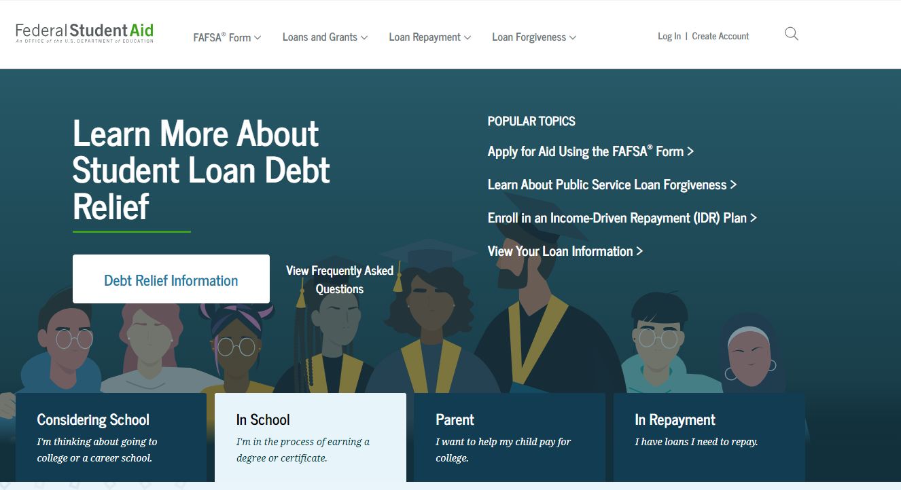
Federal Student Loans
Must complete new FAFSA each year.

Slide 11

Complete Entrance Counseling:
Entrance Counseling explains your rights and the obligations you agree to meet as a condition of accepting a Direct Loan.
Topics include: Estimate the Cost of Your Education
Paying for Your Education
Federal Student Loans
How Much You Can Expect to Borrow
Prepare for Repayment After School
Consequences of Not Repaying Student Loans

Slide 12

Master Promissory Note (MPN)
Is a contract, your agreement to repay your loans.
Can be used for multiple years (10 Years)
Read before signing
Lists your rights & responsibilities

Slide 13
24-25 Direct Unsubsidized & Additional Unsubsidized Loan
8.08% Fixed Interest Rate
1.057% Federal Loan Fee
Interest starts accruing continuously, at the point of disbursement
Automatic in-school deferment
Maximum yearly (if eligible):
  M1-$42,722 (10-months)
  M2-$44,944 (11-months)
  M3-$47,167 (12-months)
  M4-$42,722 (10-months)
Maximum Undergrad/Grad: $138,500 Maximum professional student lifetime limit: $224,000

Slide 14
24-25 Direct Grad PLUS Loan
9.08% Fixed Interest Rate
4.228% Federal Loan Fee
Interest starts accruing continuously, at the point of disbursement
Automatic in-school deferment will postpone repayment
Grad PLUS has a maximum interest rate cap of 10.5%
Maximum up to COA (if eligible)
Dept. of Education approval includes a “Credit Check”

Slide 15
Federal Loan Origination Fees
The federal loan fee is deducted from each loan by the Dept. of Education prior to disbursement.
The disbursed amount you receive will be slightly less than the amount you actually accept/borrow (your gross amount).
You’re responsible for repaying the gross amount you borrow.
Unsubsidized Loan: 1.057% Loan Fee
$20,500 + $22,222 = $42,722 Total Accepted
$216 + $234 = $450 Total Loan Fees
$42,272 “Net” Disbursed ($21,136 per semester)
Grad/PLUS Loan: 4.228% Loan Fee
$27,244 Total Accepted
$1,150 Total loan Fees
$26,094 “Net” Disbursed ($13,047 per semester)

Slide 16
Indebtedness
Data from the 22-23 LCME Part-1B Student Financial Aid Questionnaire:
22-23 UofL SOM Loan Debt
$218,018 Medical School Loan Debt
$225,254 Total Educational Loan Debt (medical school & loans prior to medical school)
22-23 Loan Debt-Data from the 22-23 LCME FASR Report
$186,853 National Average Medical School Loan Debt
$196,290 National Average Total Educational Loan Debt (medical school & loans prior to medical school)

Slide 17

Important Borrowing Advice
If you borrow, borrow wisely
Only take out loans for expenses you need (you are not required to accept all loans offered)
Know the terms and rates of loans offered to you
Learn your loan servicer and/or provider to keep track of your loans during medical school
Research alternatives to borrowing
This Photo by Unknown Author is licensed under CC BY

Slide 18

MedLoans Organizer and Calculator
The MedLoans® Organizer and Calculator was developed to assist medical students and residents with managing their education debt.
The MLOC provides a secure location to organize and track student loans while also displaying possible repayment plans and costs based on the borrower’s student loan debt.

Slide 19
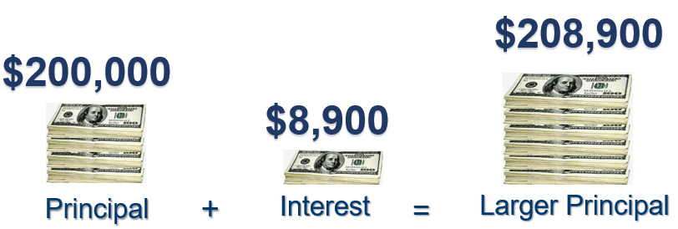
Interest Capitalization:
Addition of unpaid interest to the principal
Example:

Slide 20
Repayment Begins When:
You drop below half-time, graduate, take a leave of absence or withdraw.
You should then:
    Contact the Financial Aid Office
    Complete Federal Exit Counseling (it is required)
    Make Payment Arrangements W/Loan Servicer (Payments will start after 6-month grace period)

Slide 21

Loan Forgiveness & Repay Assistance
Military HPSP Scholarships
VA HPSP Scholarships
NHSC Scholarship and loan repayment

Slide 22

The Basics of Budgeting
Where are you getting your discretionary?
Your Total Income
Your Total Expenses
= Your Discretionary Income

Slide 23

Familiarize Yourself with Your Expenses
Fixed Expenses
Variable Expenses
Rent
Auto loan payment
Health insurance premium
Cell phone
Groceries
Clothing
Dining out
Entertainment

Slide 24
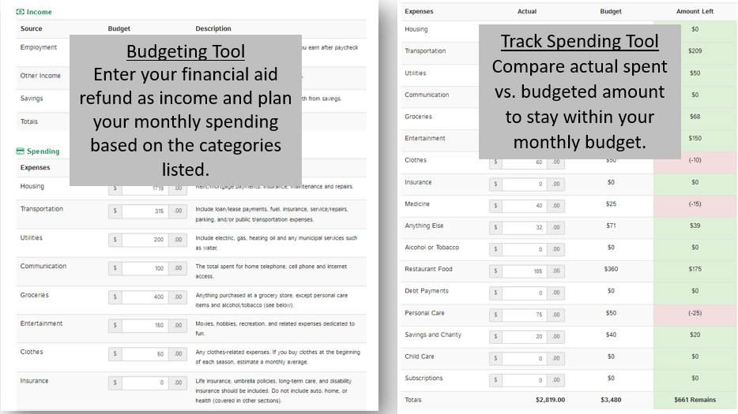
Put A Monthly Budget In Writing
Review bank or credit card statements often
Keep accurate financial records
Know your spending limits
AAMC Financial Wellness Tool

Slide 25
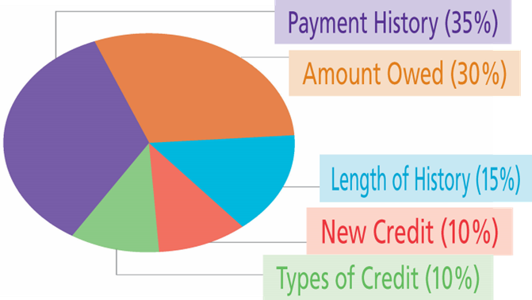
It is important to monitor your credit…even while in medical school.
A FICO Score is Based On:
Simple Steps to Improve Your Score:
    Pay bills on time
    Pay down debt on lines of credit
    Apply for credit sparingly

Slide 26
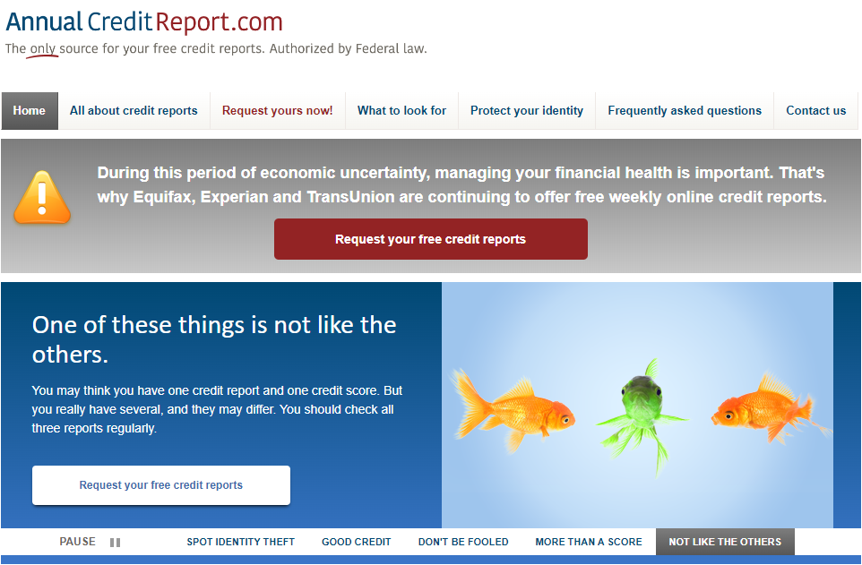
Check your
Credit Report
annualcreditreport.com

Slide 27





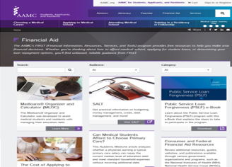
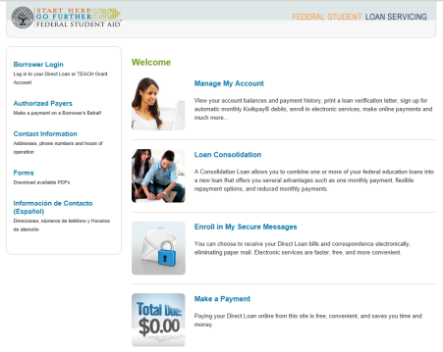
Support Along the Way….
Financial Aid Office
aamc.org/FIRST
MedLoans Organizer & Calculator
aamc.org/medloans
StudentAid.gov

Slide 28

Thank you!

