Slide 1
Muhammad Ali: global Humanitarian & peace advocate Celebrating International peace day September 21
Prepared by Enid Trucios-Haynes, Director
Muhammad Ali Institute for Peace & Justice (2021)

Slide 2
International Day of Peace ("Peace Day")
The International Day of Peace ("Peace Day") is observed wordwide on September 21 since 1981 when the U.N. created shared date for all humanity to contribute to building a Culture of Peace.
Learn more here

Slide 3
Did You Know Muhammad Ali is a United Nations Messenger of Peace?
Muhammad Ali was a relentless advocate for people in need, and a significant humanitarian actor in the developing world supporting relief and development initiatives and hand-delivering food and medical supplies to hospitals, street children, and orphanages
in Africa and Asia.
http://www.un.org/advocates/2000/bios.htm

Slide 4
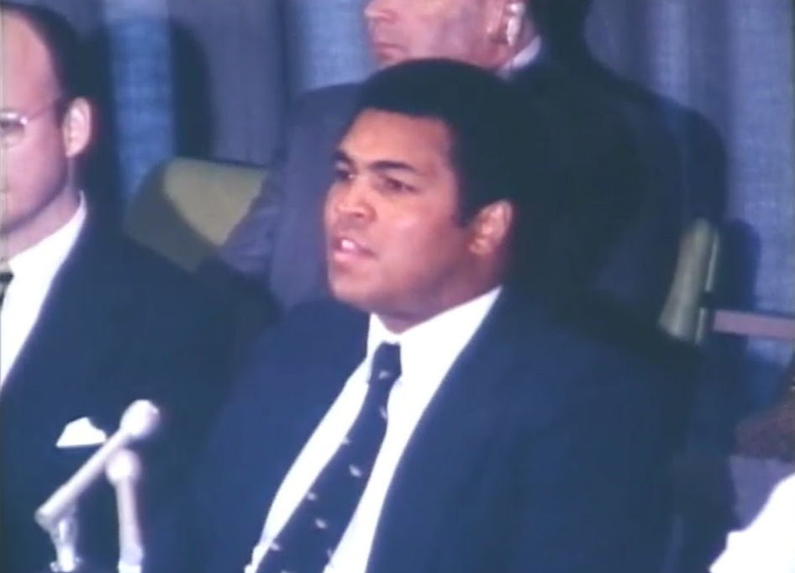
Muhammad Ali - United Nations Messenger of Peace
Muhammad Ali was appointed a U.N. Messenger of Peace in 1998
He first addressed the United Nations in 1978 at a session of the U.N. Special Committee Against Apartheid. Video of Ali’s press conference remarks.

Slide 5
Did You Know Muhammad Ali Was Part of the Global Campaign to End Apartheid in South Africa?
Muhammad Ali addressed the U.N Special Committee Against Apartheid in 1978 – video. He was part of the global campaign against apartheid at a critical time:
On November 4, 1977, the U.N. Security Council unanimously imposed a mandatory arms embargo against South Africa
On December 14, 1977, the U.N. General Assembly passed an International Declaration against Apartheid in Sports
On December 14, 1977, the U.N. General Assembly declared an International Anti-Apartheid Year
In August 1978, the U.N. hosted a World Conference to Combat Racism and Racial Discrimination in Geneva.

Slide 6
Did You Know Muhammad Ali received the 2012 Liberty “Champion of Freedom” Award from the Constitutional Center?
Muhammad Ali was recognized as:
An Outspoken Fighter for Religious and Civil Rights
A Conscientious Objector to War Who Defended His Rights Before the U.S. Supreme Court and Won
An Ambassador for Peace and Justice Worldwide
A Tireless Humanitarian and Philanthropist

Slide 7
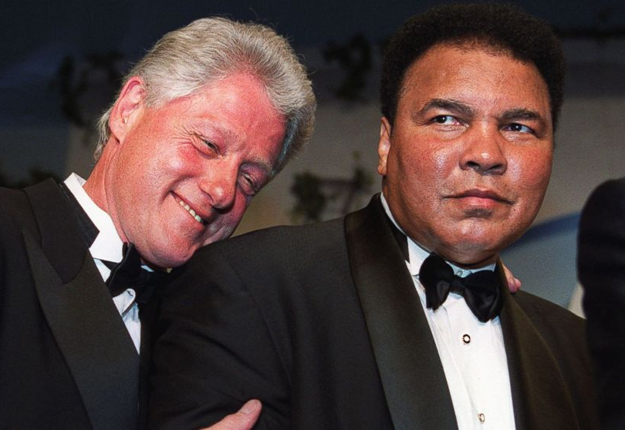
Muhammad Ali – “Champion of Freedom” Liberty Award
President Bill Clinton, Chair of the National Constitution Center, said: “Ali embodies the spirit of the Liberty Medal by embracing the ideals of the Constitution – freedom, self-governance, equality, and empowerment – and helping to spread them across the globe.”
Philadelphia Mayor Michael A. Nutter said: “For more than half a century, Ali has been committed to fighting for peace, justice, and civil rights for all in the spirit of this award.”

Slide 8
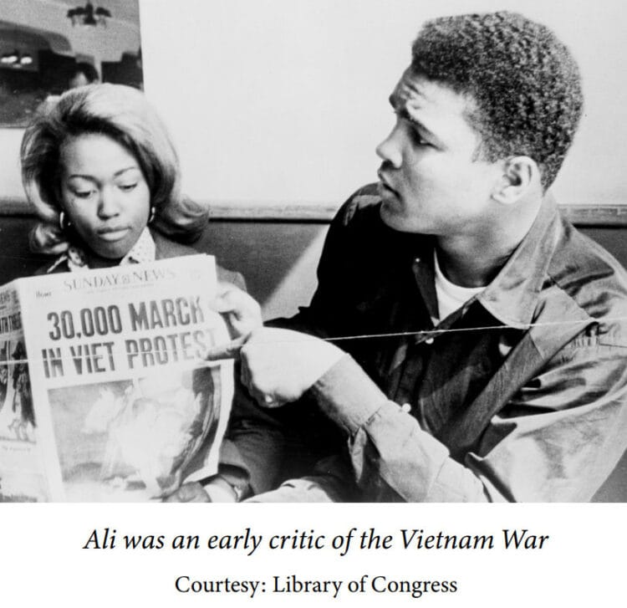
Did You Know Muhammad Ali Is Recognized Worldwide For His Request for Conscientious Objection to War in 1967?
In 1967, Muhammad Ali began his legal case in court for conscientious objection to service in U.S. Armed Forces due to his religious beliefs
He was arrested, fined, stripped of his boxing license and title, and initially found guilty of draft evasion
Muhammad Ali paid the price for his beliefs and convictions

Slide 9
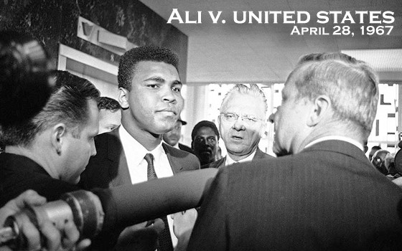
Did You Know Muhammad Ali Is Recognized Worldwide For His Refusal to Go to War in 1967?
Muhammad Ali paid the price for his beliefs and convictions
It took four years, from 1967 to 1971, for the Supreme Court to reverse his draft evasion conviction and find that Muhammad Ali had constitutionally protected religious beliefs
Ali regained his title in 1974 and retired from the ring in 1981

Slide 10
Did You Know Muhammad Ali’s Humanitarian Work Spanned 50 Years?
In 1990, he went to Iraq to negotiate the release of 15 U.S. citizens taken hostage by Saddam Hussein after his invasion of Kuwait
In 1993, he went to South Africa to meet Nelson Mandela upon Mr. Mandela’s release from prison after 27 years
In 1995, he travelled to North Korea on a goodwill mission.

Slide 11
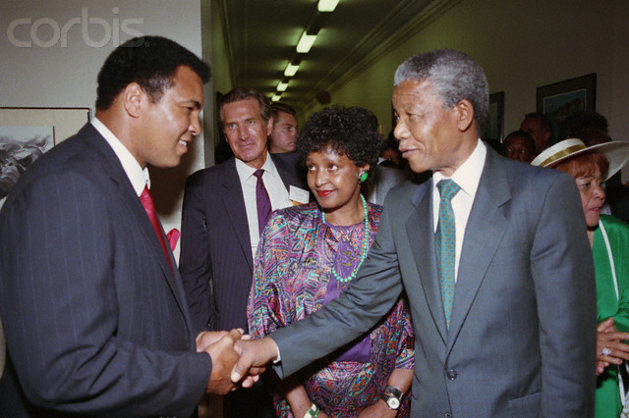
Muhammad Ali & Nelson Mandela (1990)
http://www.corbisimages.com/stock-photo/rights-managed/TL030588/nelson-mandela-shaking-hands-with-muhammad-ali

Slide 12
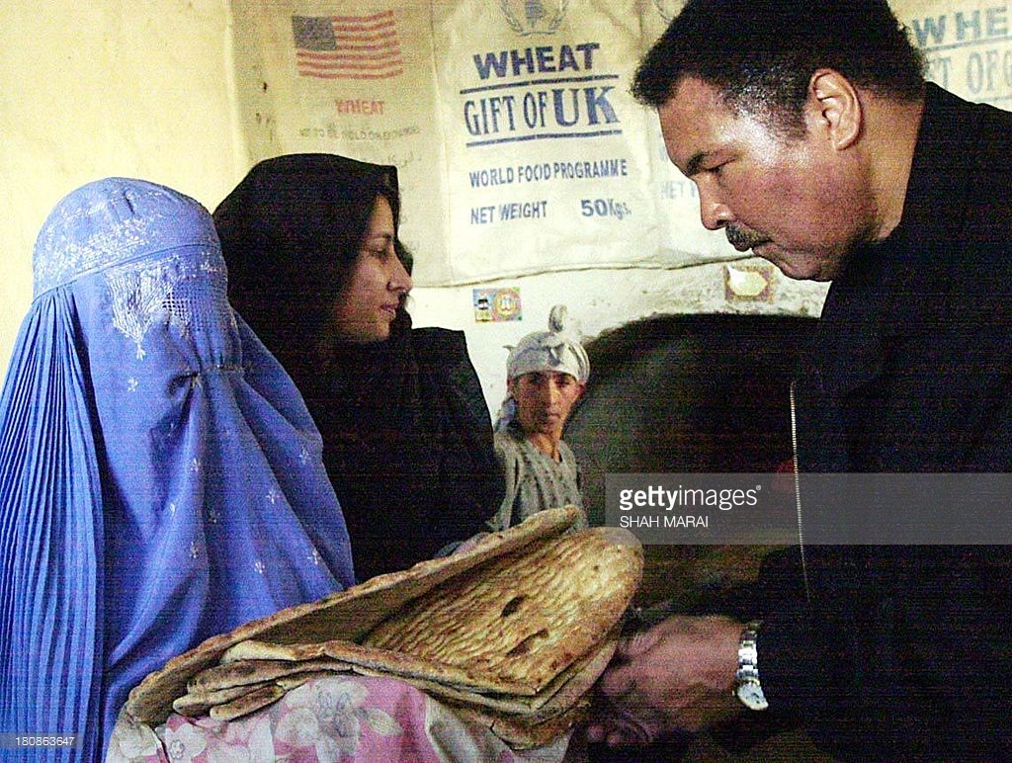
Did You Know Muhammad Ali’s Humanitarian Work Has Spanned 50 Years?
In 1998, Muhammad Ali visited Cuba with the Disarm Education Fund and donated over $1 million in medicines and medical supplies
In 2002, he visited Afghanistan to raise awareness of the country's needs and the U.N.'s work there with the World Food Program and the U.N. Children's Fund (UNICEF)
In 2009, Muhammad Ali requested Iran free 2 U.S. hikers detained in Iran, showing his tireless commitment to promoting freedom, tolerance, and humanity around the world.

Slide 13
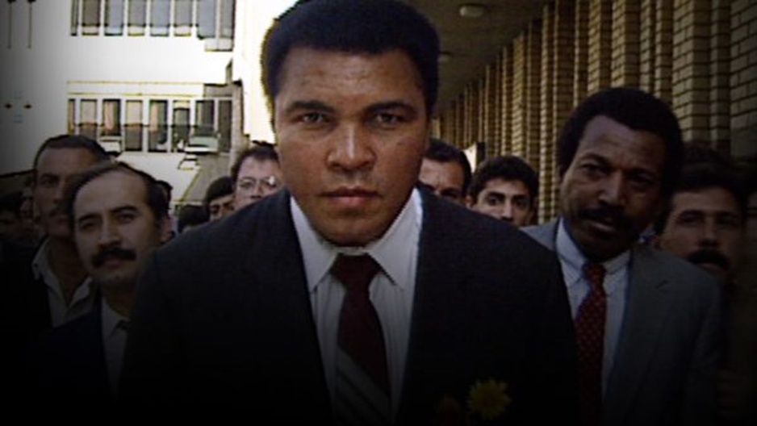
Did you know that Muhammad Ali was a revered ally of American Indian Nations in the United States?
Among the hostages rescued in Ali’s 1990 mission to Iraq, six were American Indian elders, including Chief Looking Horse, and their peace delegation.
To this day, many in the American Indian Nations are grateful to Muhammad Ali for having helped save one of their most important leaders.

Slide 14
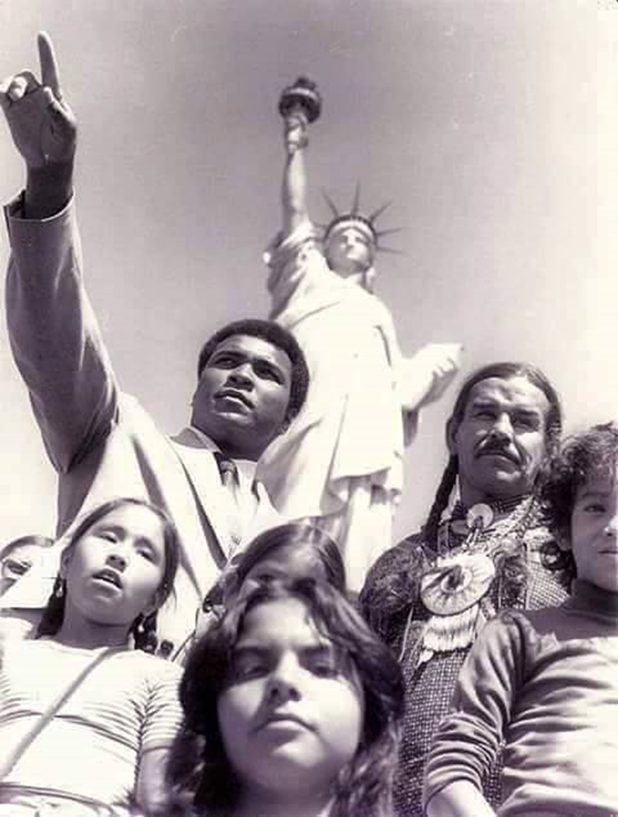
Muhammad Ali - Revered Ally of American Indian Nations?
Ali supported The Longest Walk in 1978 at events in New York City, and walked with the group into Washington D.C.
Mohawk activist Lorraine Canoe and others at the American Indian Community House took the ferry to the Statue of Liberty with Ali to be at the press conference he had called to support A.I.M. She recounts how he told the press, “Look at all these good-looking Indian people, aren’t they beautiful, aren’t you jealous?”
http://indiancountrytodaymedianetwork.com/2016/06/13/muhammad-ali-stood-native-americans-every-chance-he-could-164777

Slide 15
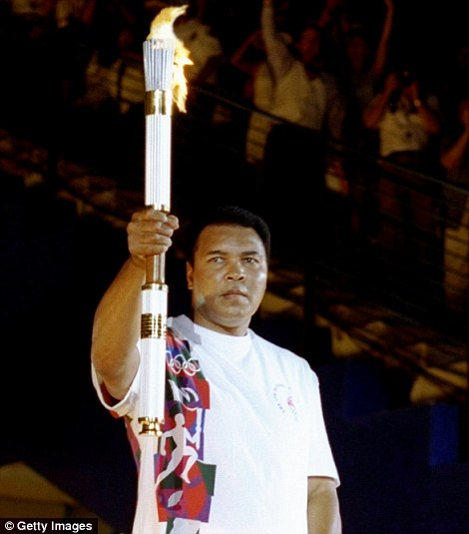
Did You Know that Muhammad Ali, as an Olympian, promoted peace and justice?
In 1996, Muhammad Ali went to the Olympic Games Opening Ceremony in Atlanta, Georgia
to light the Olympic torch.
It was described as the most dramatic moment
at the Olympic Ceremony and
one that moved people to tears.

Slide 16
To learn more about Muhammad Ali: global Humanitarian & peace advocate
Visit UofL Libraries - Muhammad Ali: A Transcendent Life Research Guide and Timelines
Contact the Muhammad Ali Institute for Peace & Justice

